Slide 1
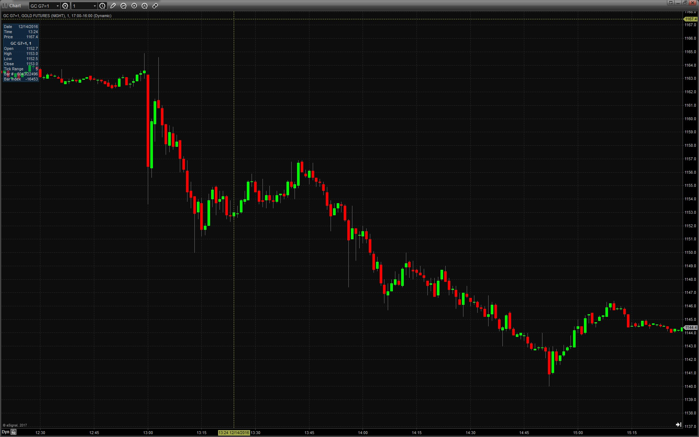
Trading FOMC 12/14/16
A look at ZN, ES, 6E and GC

Slide 2
What is the Fed?
12 voting members that represent regional areas of the US (Some are permanent, some rotate)
Monetary policy making board
Dual mandate of maximum employment and stable prices (inflation)
Typically uses short term interest rates to conduct policy

Slide 3
Federal Reserve Meetings
Meets 8 times per year, usually 6 weeks apart
Statement and projections realeased at 1pm
Press conference begins 30 minutes later
Each quarter, the meetings include economic projections and a press conference

Slide 4
Expectations vs Outcome
The market will react to the difference between expectations and outcome
Ahead of 12/14, markets had a 25 bp hike completely priced in
The reaction came from the surprise in the increase in the “dot plots”
Yellen’s testimony did little to stop the momentum in the market

Slide 5
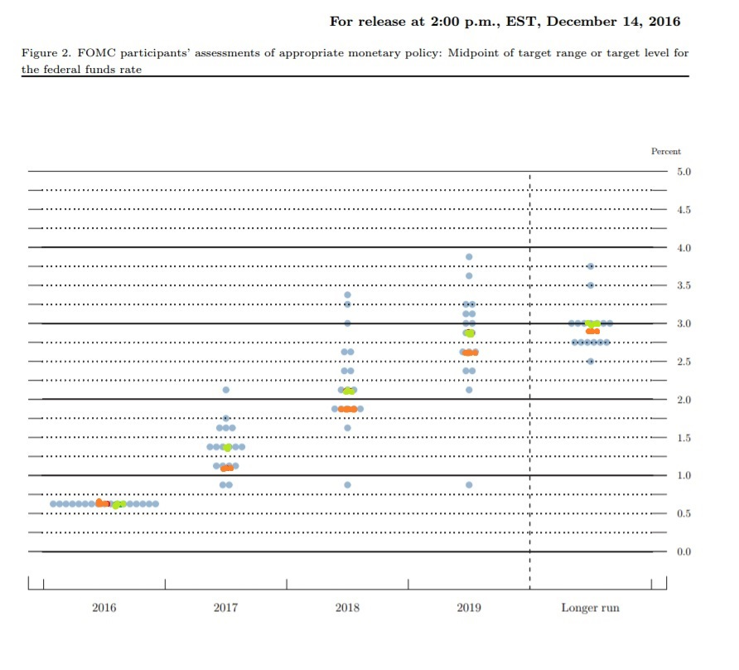
What mattered today

Slide 6
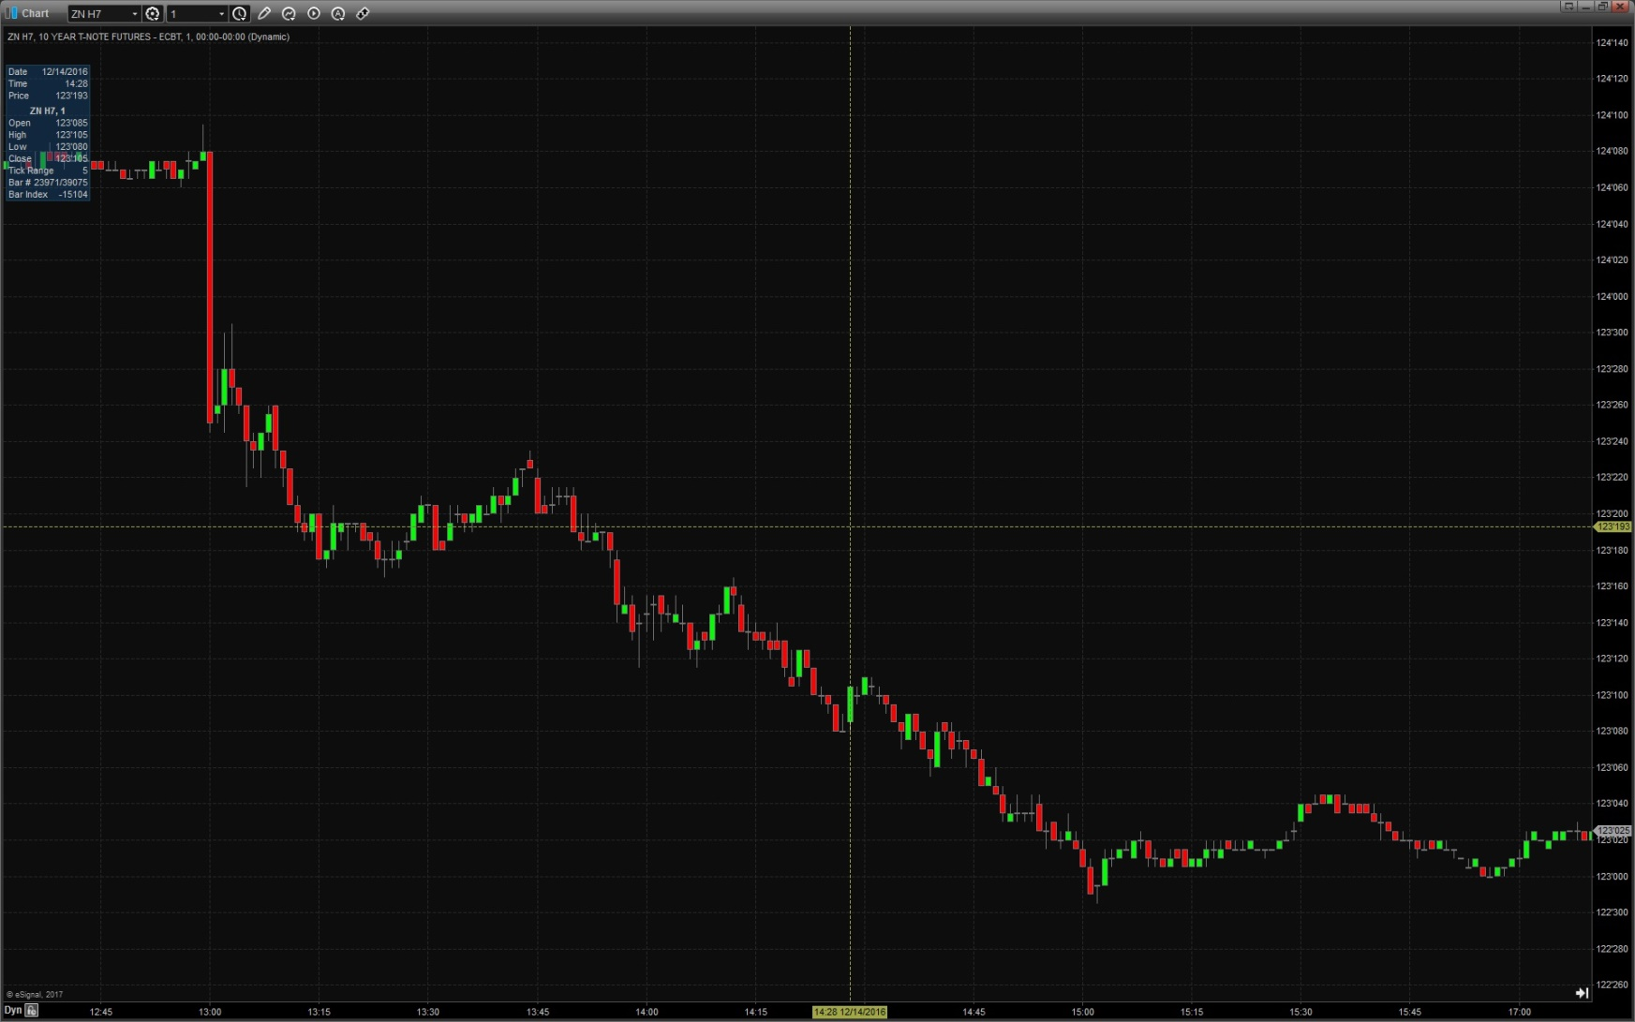
ZN H7 - US Ten Year Futures

Slide 7
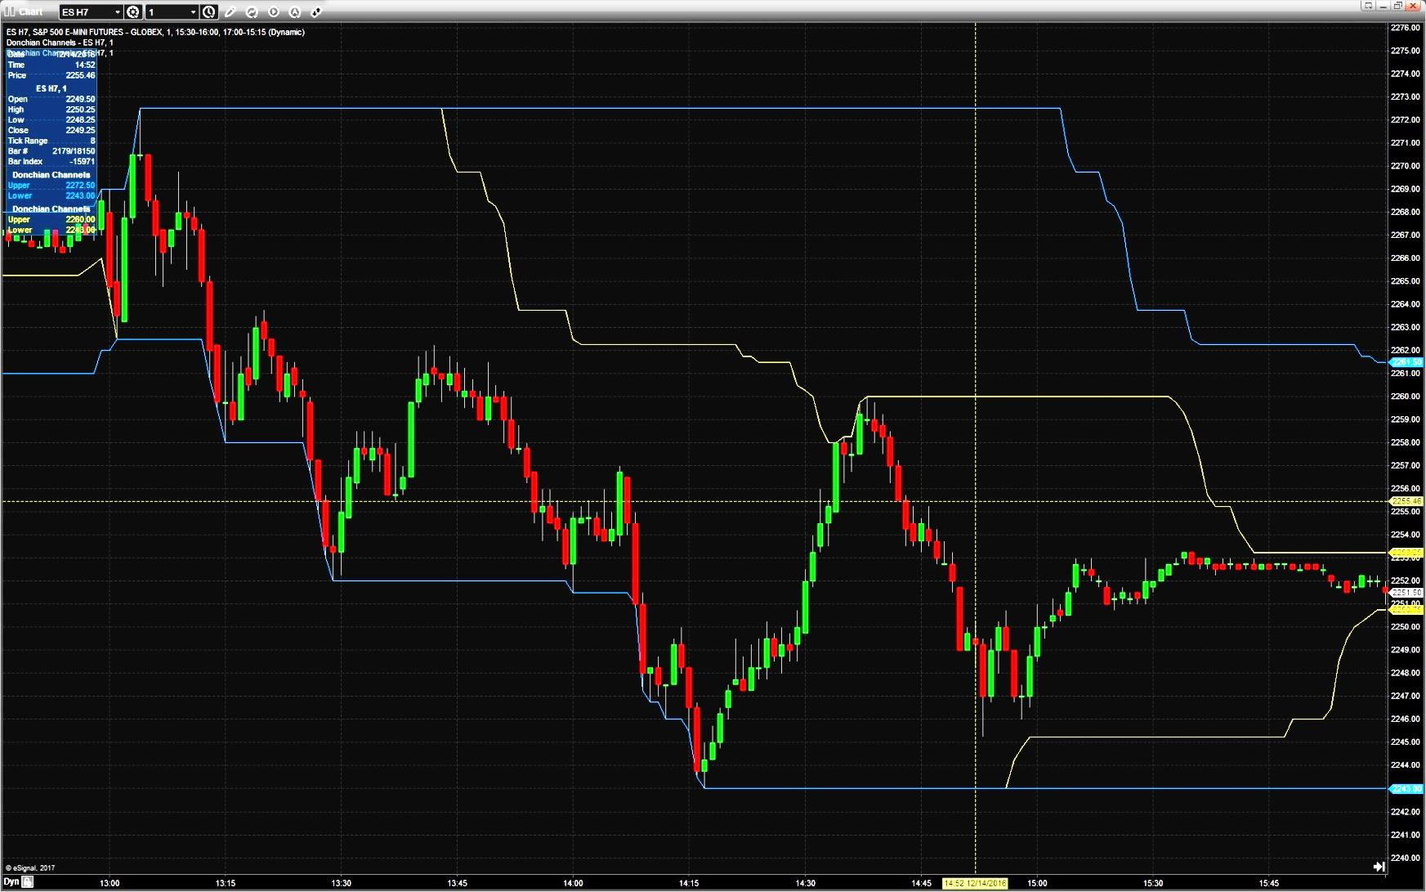
ES H7 – S&P 500 futures

Slide 8
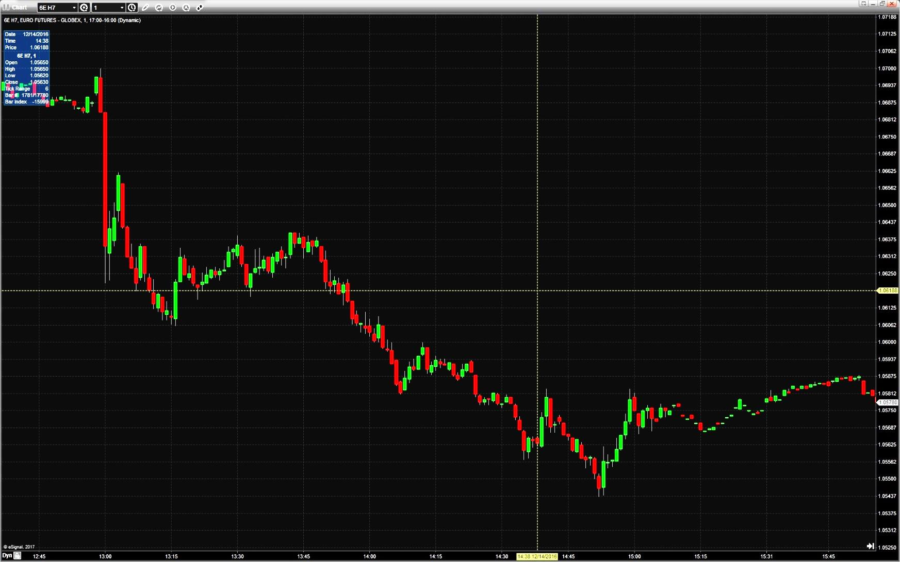
6E H7 – Euro Currency Futures

Slide 9
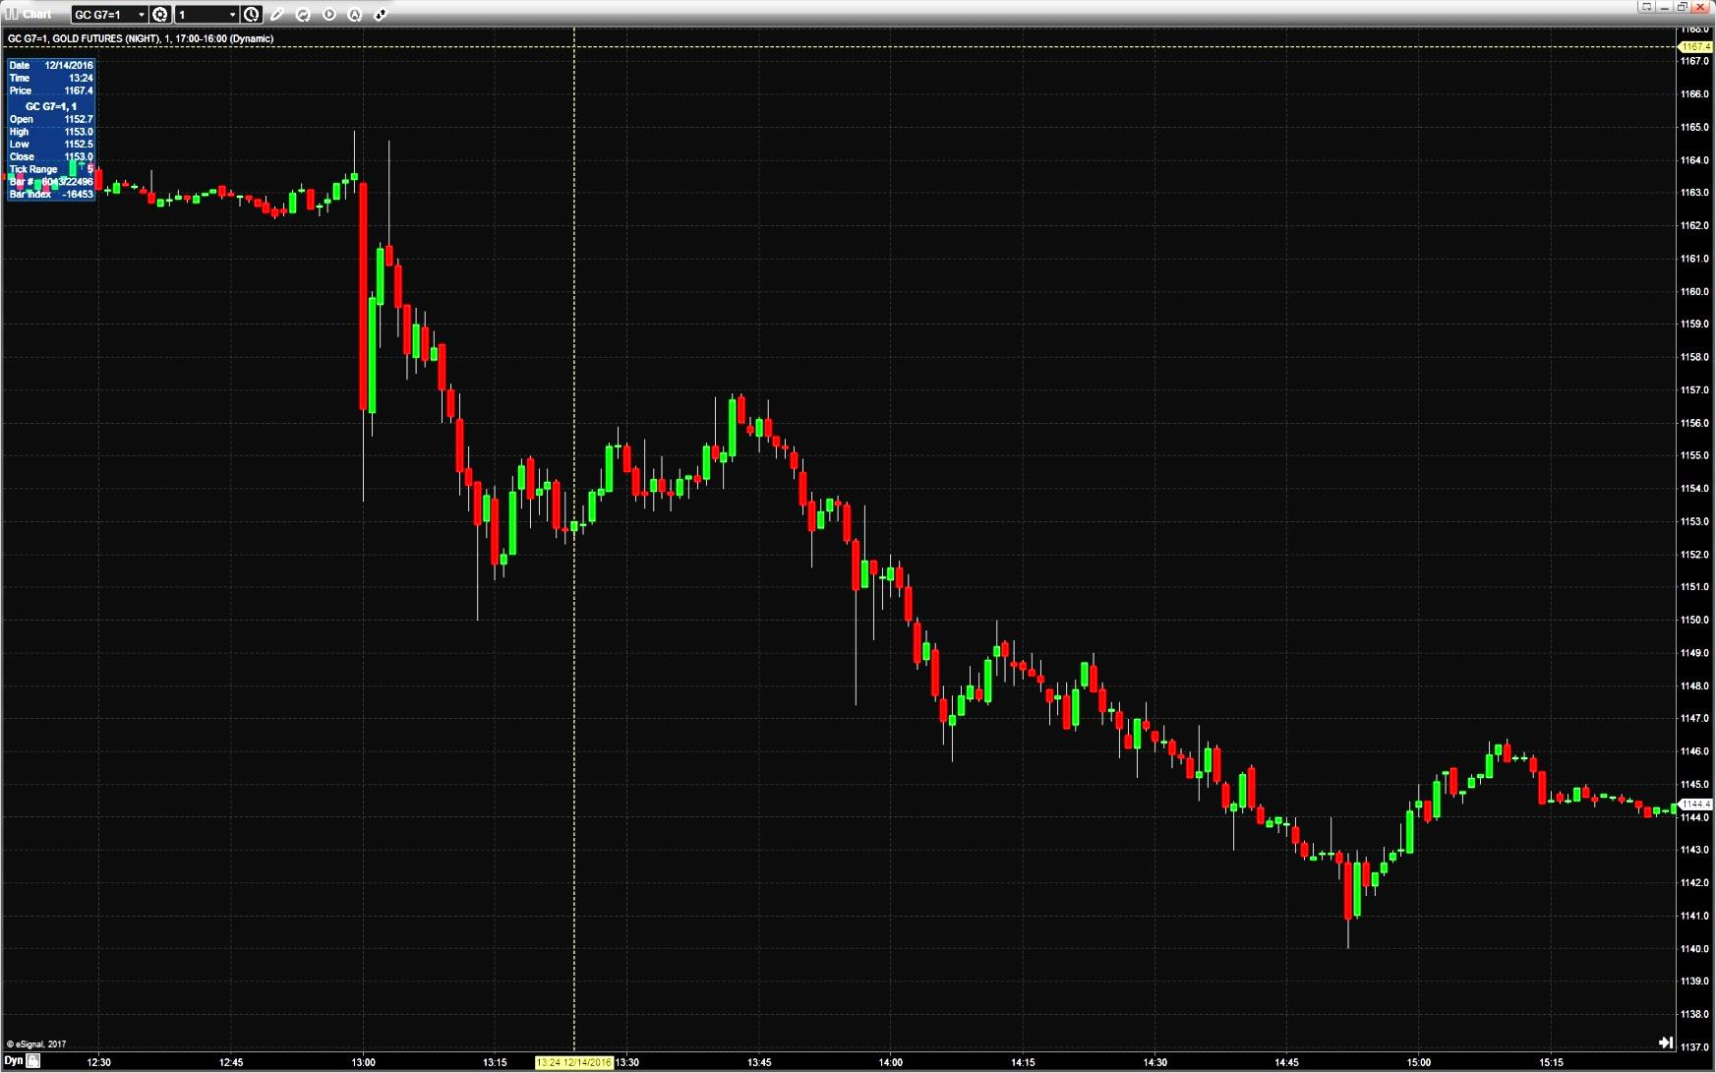
GC G7 – Gold futures

Slide 10
Conclusions
Understanding the data
Interpreting the results
Finding value in the markets
Executing your ideas
What parts of the process can become automated?

